Slide 1




Student Competition with Business Simulator & Career Days 2016-17
Student Presentation
Organized by
Partner

Slide 2
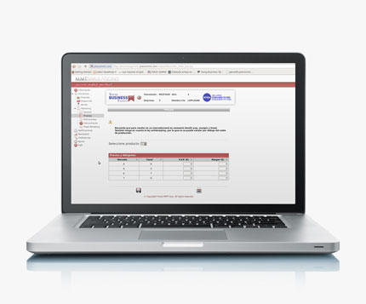
What is BUSINESS TALENTS
A unique Competition with Simulator for practice in Business Management and Entrepreneurship
You run your own (virtual) Company, with your Team of 3-4, taking real Decisions and Results
In competition, for 11 ‘Years’
For Students & Graduates ages 17-29
Free for all University level institutions
Online on the Internet & Live
Across Greece

Slide 3
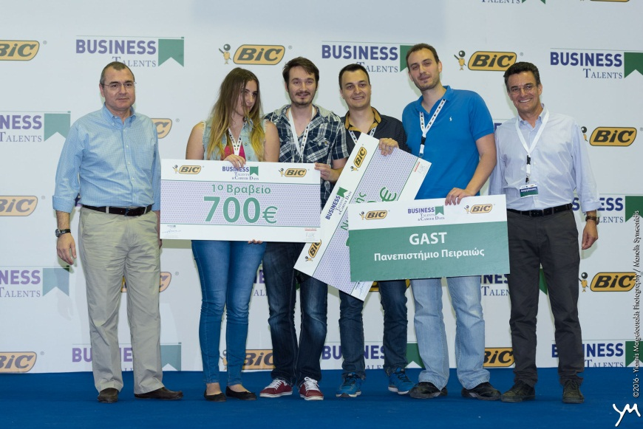
What is BUSINESS TALENTS
Ends with a unique live FINAL Event 26 May 2017
Runs 4 months, February – May
Offers PRIZES 7.500 €, Diploma, gifts…
… and the amazing experience of managing your own company, in a self-educating amusing process
Registrations NOW OPEN
www.businesstalents.com
Form your Team and enjoy !

Slide 4


Please watch
VIDEO
ΒUSINESS TALENTS FINAL
& CAREER DAY 2015/16
3 & 4 June, 2016
Hosted at
http://bit.ly/BT-GR-Final-1516

Slide 5

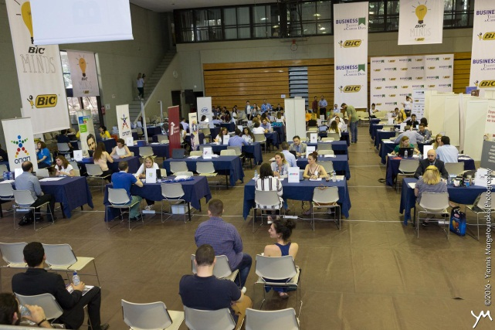
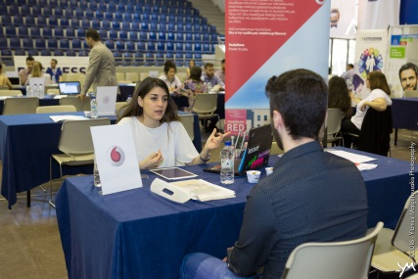
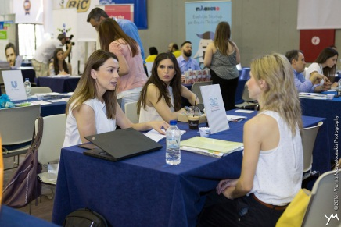
What is CAREER DAY
Α daily Event 27 May 2017
Where top Companies meet Students and Graduates for interviews & advise
Companies searching for ‘Talents’, receive CVs in advance, through BT website
Also company activities during the year
Registration together with BT Competition at www.businesstalents.com

Slide 6























CAREER DAY 2015-16
4 June
PARTICIPATING COMPANIES
BIC ΒΙΟΛΕΞ ΑΕ
ACCENTURE AE
ARLA FOODS HELLAS S.A.
BARILLA HELLAS ΑΕ
BEIERSDORF HELLAS AE
COCA COLA ΤΡΙΑ ΕΨΙΛΟΝ ΕΛΛΑΔΟΣ ΑΒΕΕ
COSMOTE ΚΙΝΗΤΕΣ ΤΗΛ/ΝΙΕΣ Α.Ε.
HENKEL HELLAS ΑΒΕΕ
IKEA
IMPERIAL TOBACCO
JACOBS DOUWE EGBERTS GR ΕΠΕ
JUMBO
LIDL HELLAS
MICROSOFT HELLAS
MONDELEZ ΕΛΛΑΣ ΑΕ
PWC BUSINESS ADVISORS
Teleperformance
VODAFONE-ΠΑΝΑΦΟΝ ΑΕΕT
ΕΛΑΪΣ UNILEVER HELLAS
ΟΠΑΠ ΑΕ
ΠΑΠΑΣΤΡΑΤΟΣ ΑΒΕΣ
ΠΛΑΙΣΙΟ COMPUTERS AEBE
ΦΑΜΑΡ ΑΕ

Slide 7

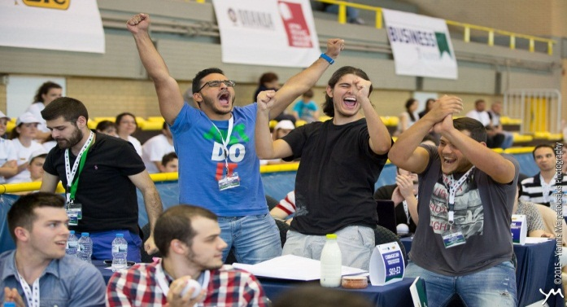
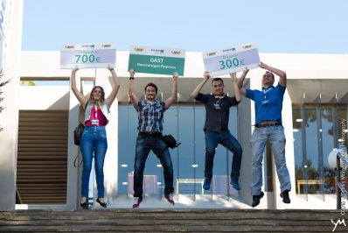
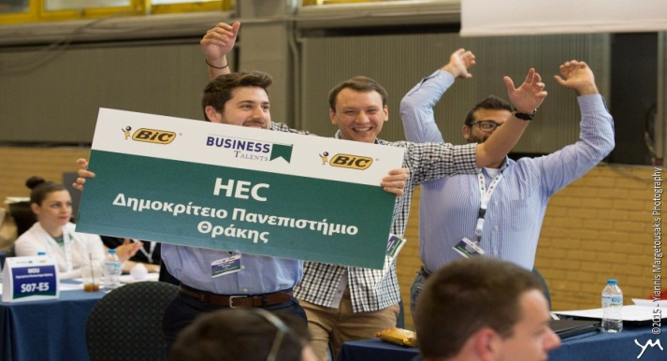
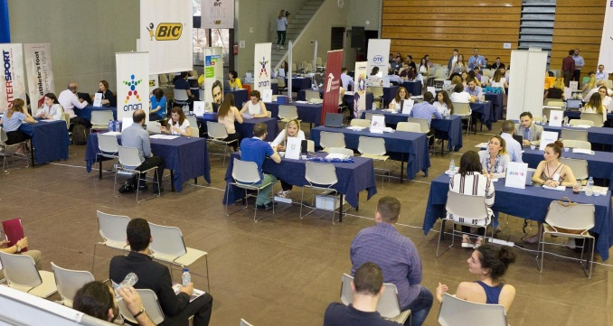
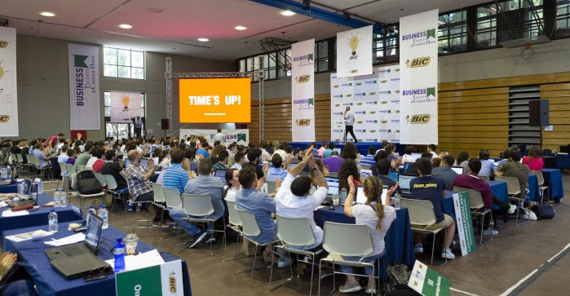
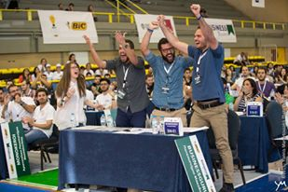
Success has measurable and not measurable aspects !
Enthusiasm, teamwork, engagement, emotion, commitment, effort, cooperation, persistence have no KPIs …

Slide 8
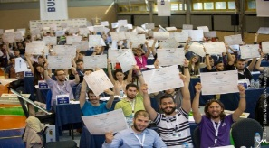
BUSINESS TALENTS Objectives
Competition with Simulator
  Offers you with a unique opportunity to practice
  Business Management, learning by doing
  Builds Business Skills, bridging theory with practice :
    Strategy, Planning, functions of Marketing – Finance – HR – Production - Logistics, Analysis of : Competition - Financial Accounts - Market research reports
  Develops basic Managerial (soft) Skills of :
    Team-work, communication, critical thinking, decision making, problem solving, innovation, risk taking, analysis & synthesis
  Promotes fundamental Values of :
    Responsibility, effort, perseverance, ethics, healthy competition
  Develops Entrepreneurial thinking and initiative
  Contributes to building Professionals and Leaders of the future

Slide 9
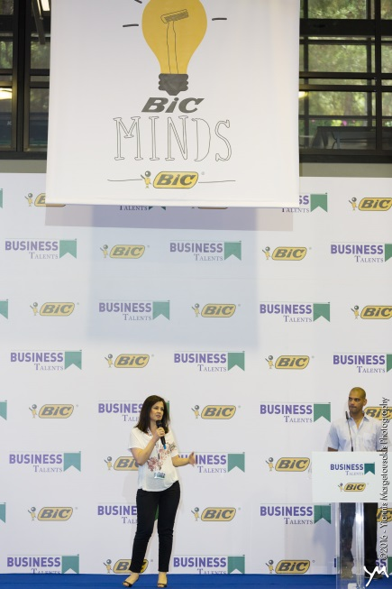
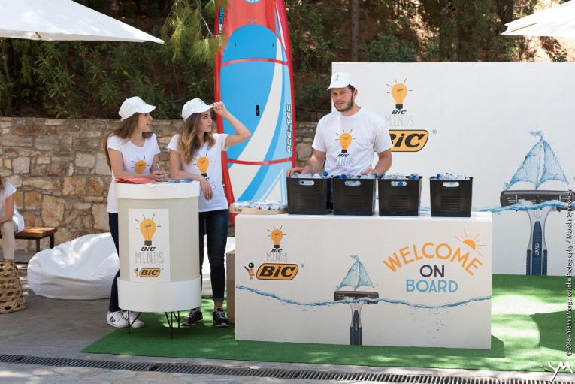
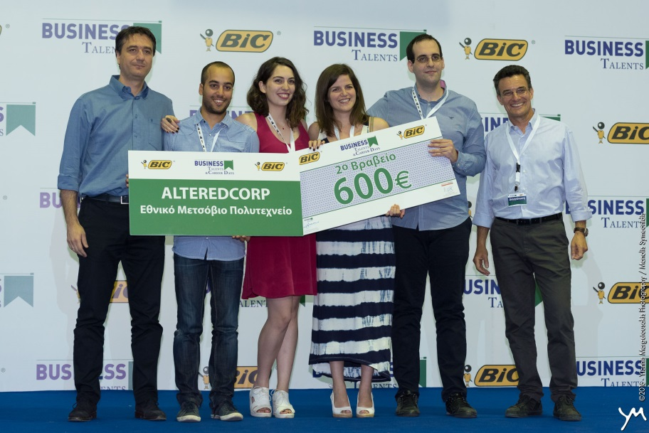
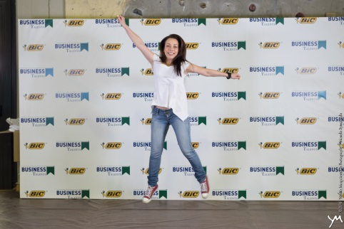
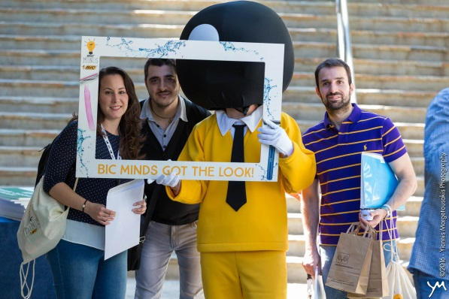
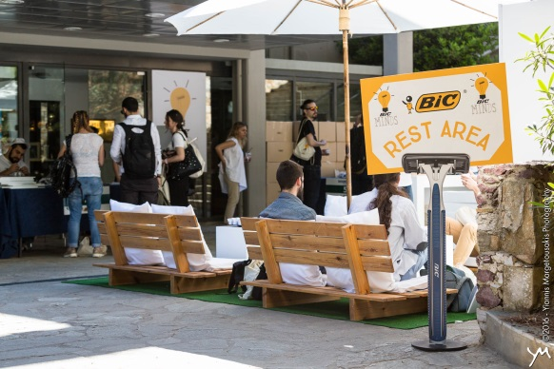
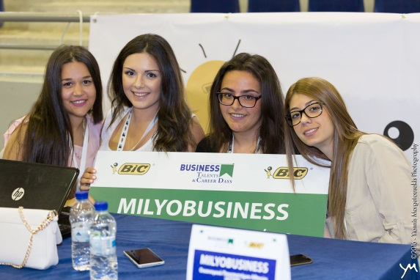
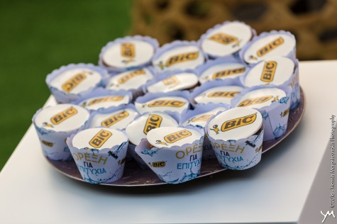
Sponsored by companies!

Slide 10

How the BT Competition operates :
Students form mixed Teams, virtual ‘companies’ of 3-4 members, and register October to February in the Competition. (No restriction of number of teams per university) at : www.businesstalents.com
They submit their CV for CAREER DAY : to be visible by participating companies well before the Event of 27 May 2017.
Teams compete in a virtual ‘Market’ against 4 other, in the same group, during virtual 11 ‘Years’ (each lasting one week in real time).
Starting February up to beg. May the ‘Years’ are : 2 Trial + 3 Rounds of 3.
‘Companies’ start with (the same) Scenario (case study) describing their business and market, with a starting capital. They are invited to formulate a Strategy and take Decisions which they submit as a Plan each ‘Year’.
The Simulator compares 5 companies in the group and returns Results, a Sales - Profit (or Loss) and Balance Sheet.
Depending on ranking in groups of 5 (1st..5th) Teams gets points to collect.
The Top 75 teams with maximum points and profitability, will qualify to the Athens Live Final, 26 MAY 2017.
They are rewarded with a Diploma and Prizes at the Final

Slide 11
BUSINESS TALENTS
& CAREER DAY
Is the No1 Program for students & graduates, Free in Greece…
… in terms of an active practical experience
with more than 7.500 participants
In the 3 years of operation, exp.>3.000 in 2017
Unique combination of Practical exercise with career opportunities
Supported by top Companies, as a CSR Program, offering to the Young in Education.

Slide 12

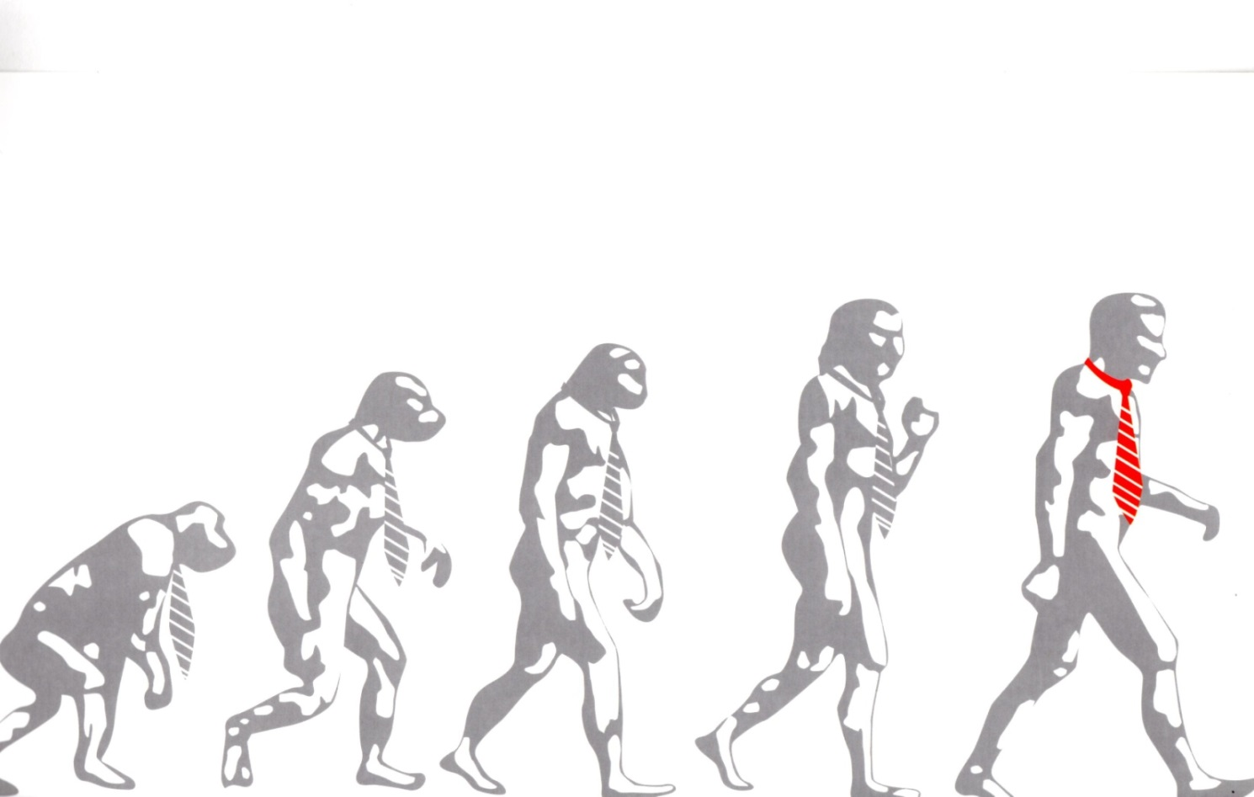
The educational – experiential
Business Game is based on
Business Simulator
advanced 3rd generation software that emulates the market & business functions with real data and results, created by

Slide 13



Spanish company,
Leader in its field, with presence
In Europe, USA, Latin America,
Expert for 22 years in
Business Simulators
Innovative tools used for Training & Development by Companies, tens of Universities (BT), and now High Schools (YBT)

Slide 14
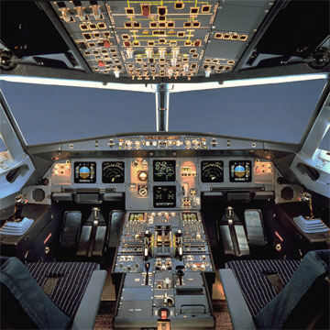
The best Analogy
http://bit.ly/BT-GR-Final-1516

Slide 15

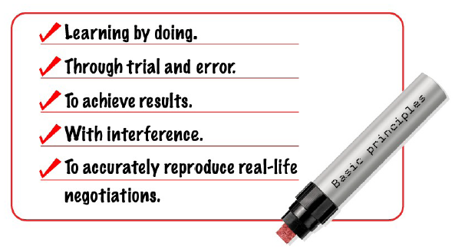
Principles
of Business Simulation :

Slide 16
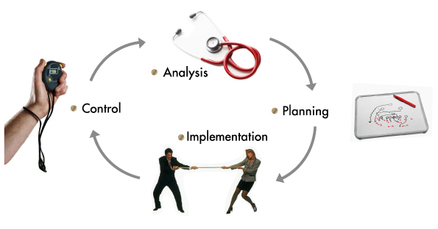
A Business Simulation
Emulates the variables that comprise a given business reality (a dynamic scenario) and the main functional areas within a company.
Participants will receive training in management in a risk free environment doing what managers do, going through the business management cycle:
  Analysis.
    Planning.
    Implementation.
    Control.
They will manage a company over several “periods” to reach a more effective training.

Slide 17
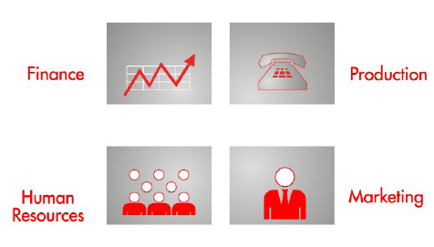

Real Decision Making
In company functions, 240 :
Logistics

Slide 18
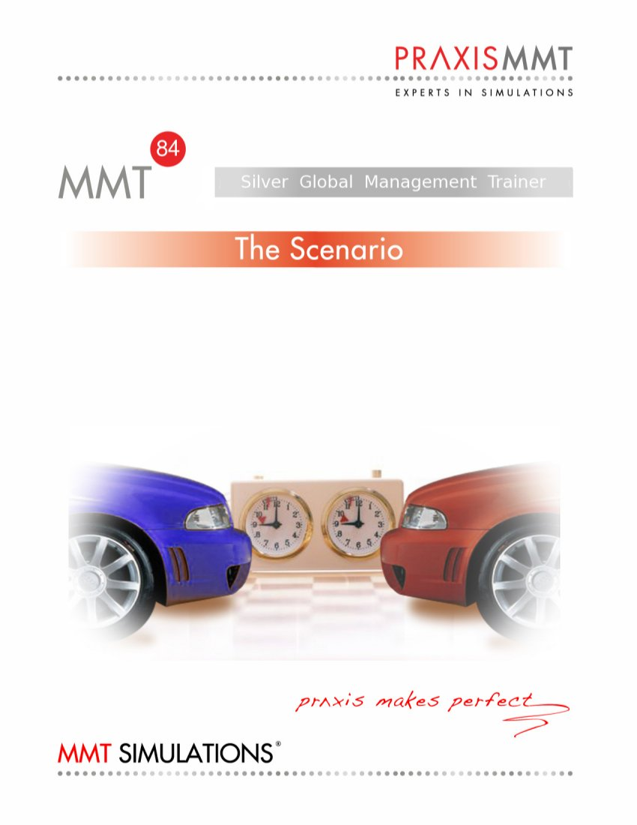
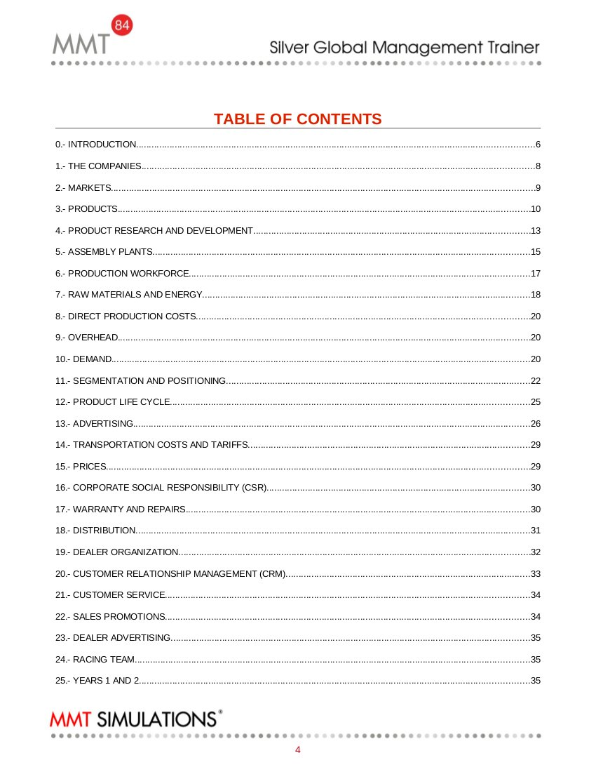
Simulation features: the Scenario

Slide 19
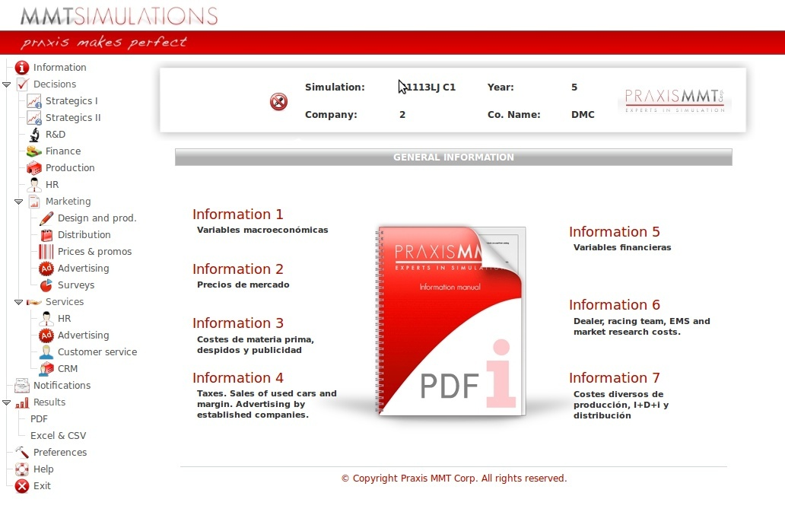
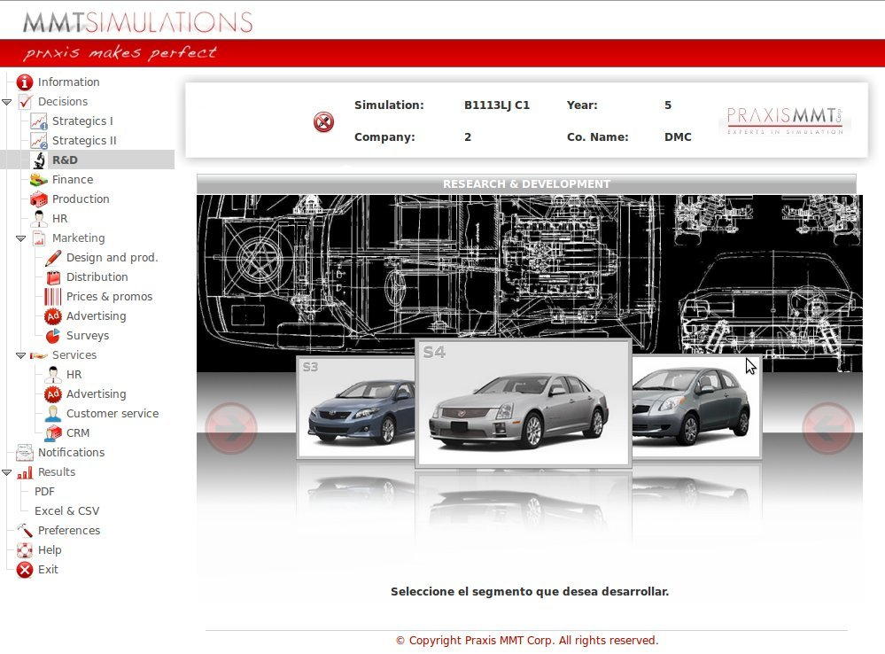
Simulation features: the Interface

Slide 20
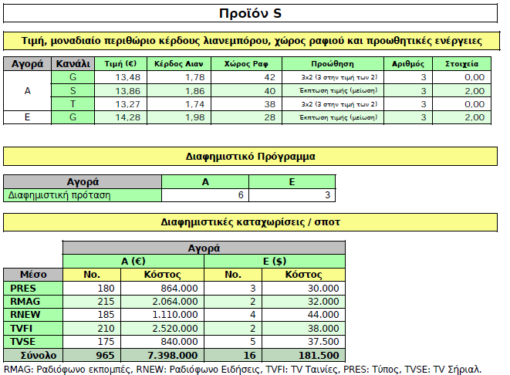
Real Decision Making
In company functions, 240 :

Slide 21
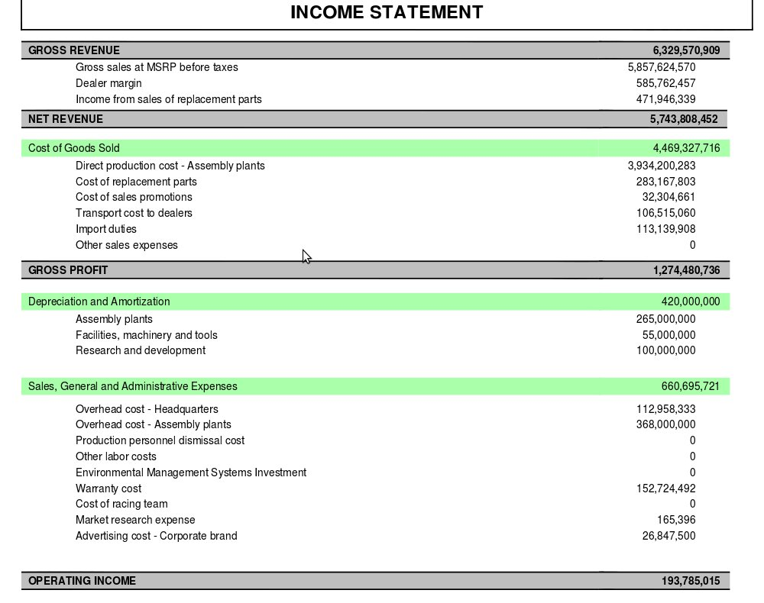
Real company Results
Sales, Profit / Loss

Slide 22
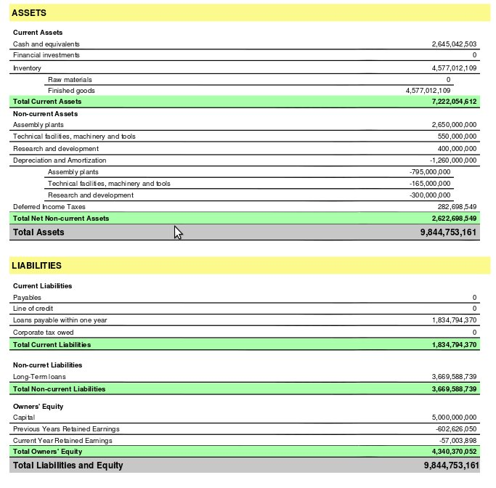
Real company Results
Balance Sheet

Slide 23
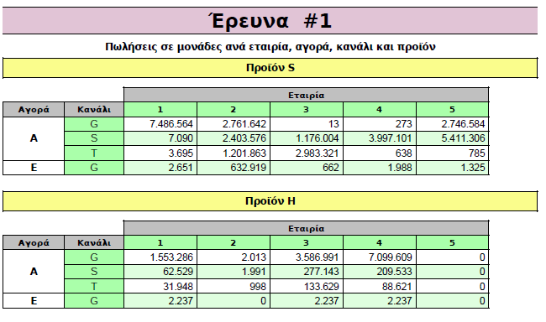
Real company Results
Market Surveys : competitors decisions

Slide 24
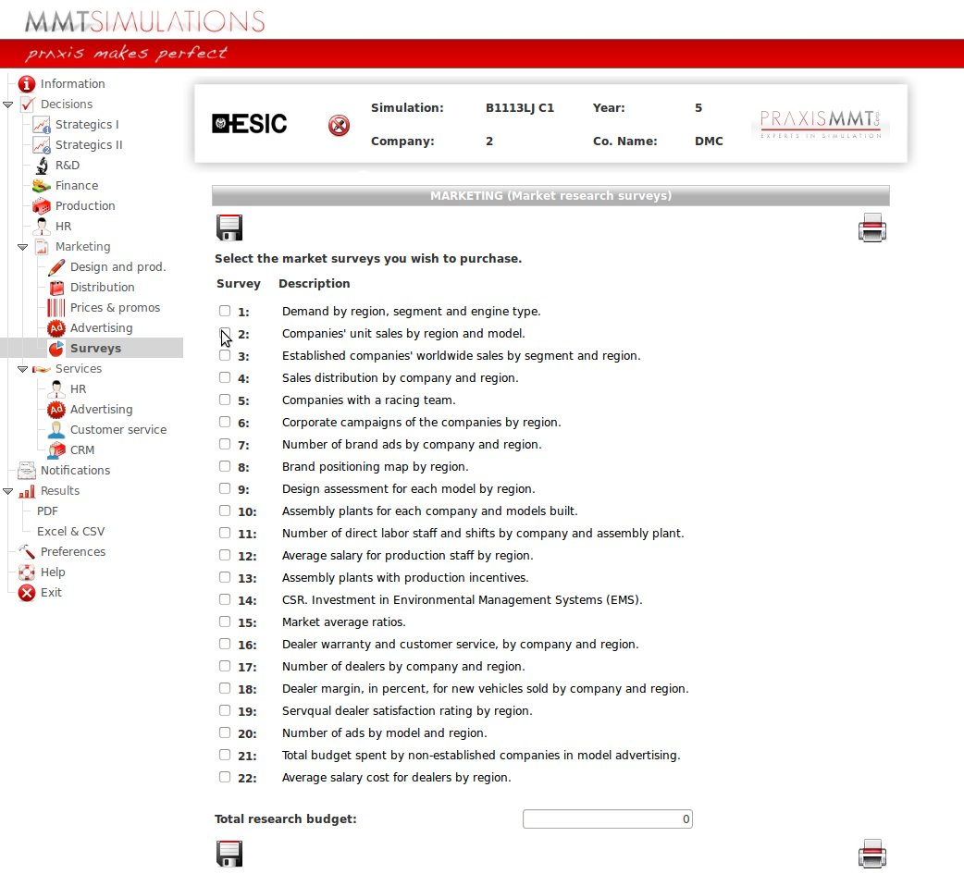
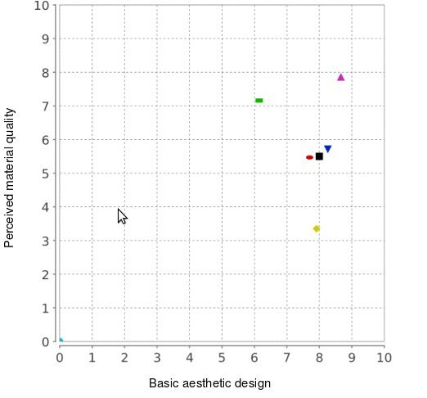
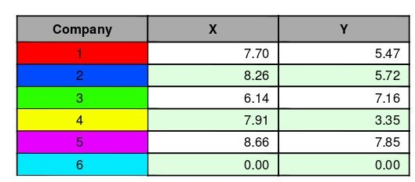
Simulation features: Market data

Slide 25
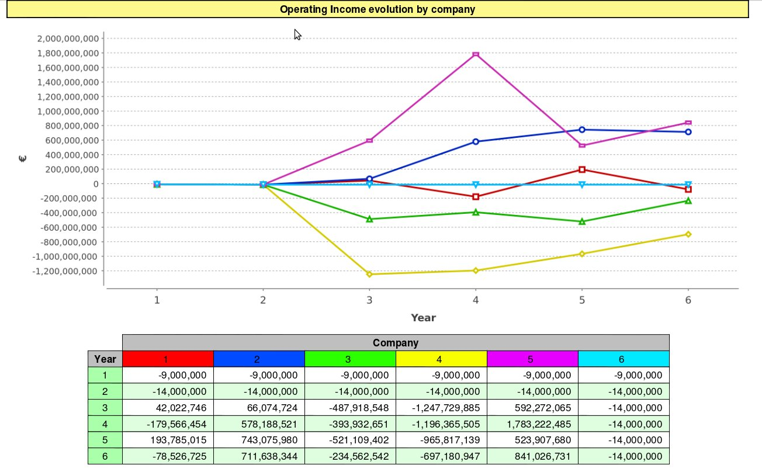
Simulation features: Results

Slide 26
Results of practical
Business Training with Simulator
Degree of ‘absorbing’ material depending on methodology used
Private Lesson
‘Learning by Doing’
Group Dynamics
Presentation - Demo
Audio & Visual
Material Reading
Lecture (plain)
Fuente: National Training Laboratory
Source : Research ‘National Training Laboratory’ of Spain

Slide 27
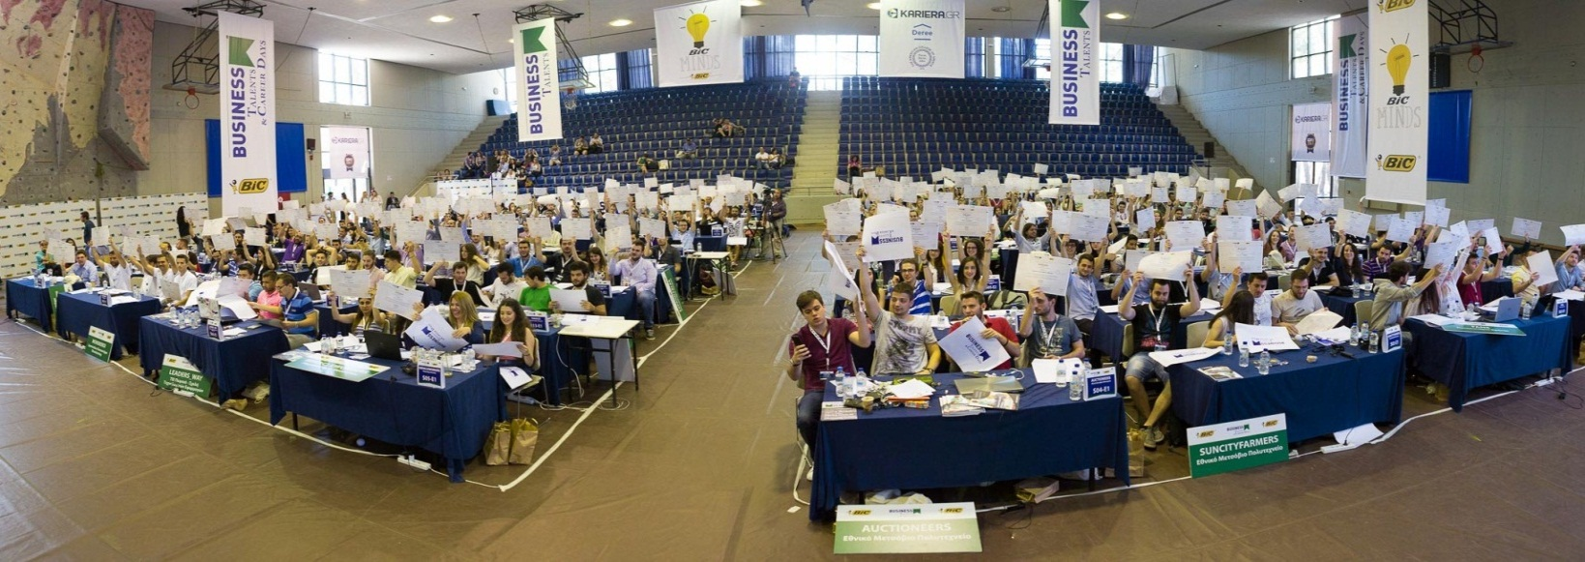
BUSINESS TALENTS & CAREER DAY
Success of a new, unique concept
Following 2 years of BT Competition in Greece, in 2015/16 we organized ‘BUSINESS TALENTS & CAREER DAY’ combining the Final event of 3 June, with a day of interviews and presentations by top Companies, exclusively for the participants of BT, on 4 June.
Both projects targeting University level students and graduates (ages 17-29), achieved excellent results in terms of participation, media publicity, ROI and brand awareness for sponsors.

Slide 28
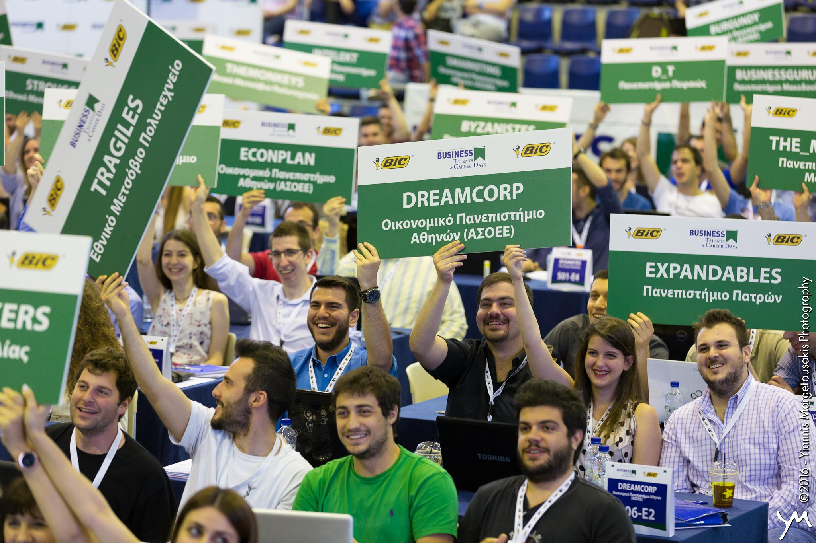

BUSINESS TALENTS & CAREER DAY
Success of a new, unique concept
Participants grew to 2.792 (+31%), coming from 72 educational institutions in 2015/16 vs 2.124 and 49 e.i. in 2014/15. Only 436 were repeat.
Media Publicity, (offered free), nearly doubled in 2015/16 to 113.000€ *, offering high ROI, from 67.000€ in value* 2014/15.
Awareness of sponsorship in Universities is estimated at least 10x the participants (based on ‘reach’ of marketing actions during registration, the competition and media).
Value measured with media prices, as if time or space was bought. All publicity offers for free, expect for 3.000€ Radio spots bought.
Value figure of 2015/16 also takes into account media publicity of Career Day and GenY projects which were parts of the sponsorship.

Slide 29

Report 2015-16
COMPETITION PARTICIPANTS DATA
BT 2015-16 (vs 2014-15)
NUMBER of PARTICIPATING STUDENTS 2015-16 vs 14-15 | ΒΤ 2015-16 EDUCATIONAL INSTITUTIONS | NUMBER of EDUCATIONAL INSTITUTIONS
2.159 - 1.664 (+30%) (77,3 - 78,3%) | UNIVERSITIES | 23 - 21
326 – 355 (-8%) (11,6 - 16,7%) | TECHNOLOGICAL INSTITUTIONS (T.E.I.) | 18 - 17
306 - 105 (+190%) (10,9 - 4,9%) | PRIVATE COLLEGES & IEK (Vocational Institutions) | 31 - 11
2.792 vs 2.124 (+31,4) | TOTAL | 72 - 49

Slide 30
Report 2015-16
1b. COMPETITION PARTICIPANTS
Characteristics
No of PARTICIPATING STUDENTS | STUDENTS CHARACTERISTICS
2015-16 vs 2014-15
2.792 - 2.124 = | TOTAL
285 (10%) vs 158 (7,4%) 252 (9%) in 2015-16 | In Graduate Studies Graduates
+ 2.254 (80%) vs 1.966 (92,6%) | Undergraduates
Or 1.864 (67%) vs 1.362 (64,1%) | In Business & Economics studies (incl. Maritime, Tourism & relevant)
+ 787 (Engineers) + 140 = 927 (33%) vs 762 (35,9%) | Other Studies : Engineers, Computers, Law, Medicine, Languages, Architecture, Physiotherapy !

Slide 31
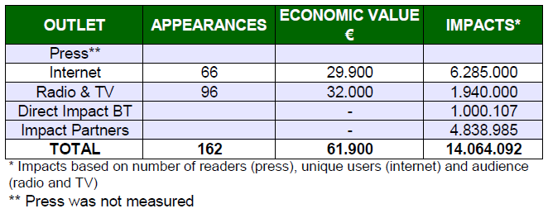
Report 2015-16
2. EXPOSURES AND ADVERTISING VALUE
GENERATED BY BT
Aggregates by type of Media
Figure does not include €51.200 publicity of Career Day & GenY
2014-15 was 166 Appearances and 67.000€ Value

Slide 32
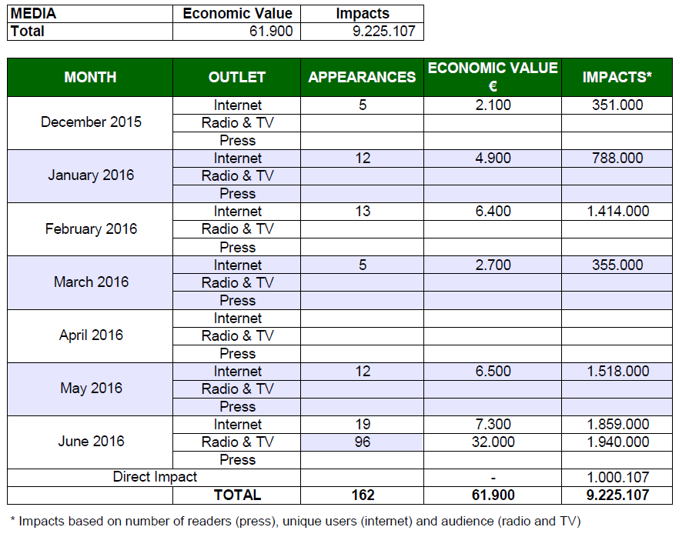
2b. BT 2015-16 : Exposures by month & medium

Slide 33
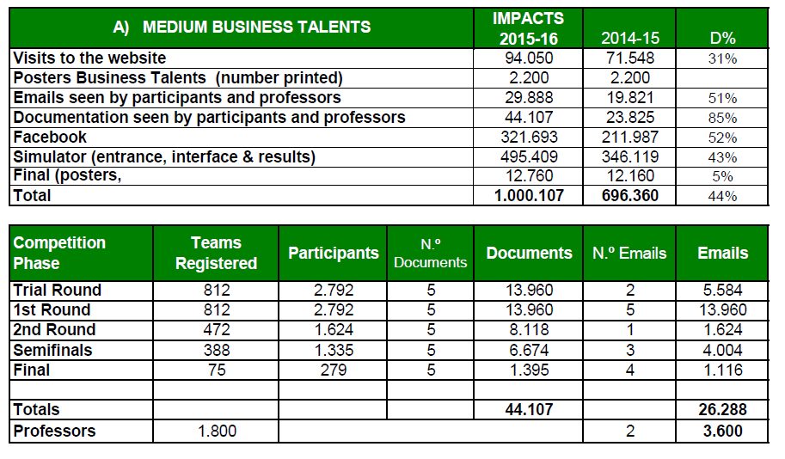
2c. Direct Impacts : BT own Media

Slide 34
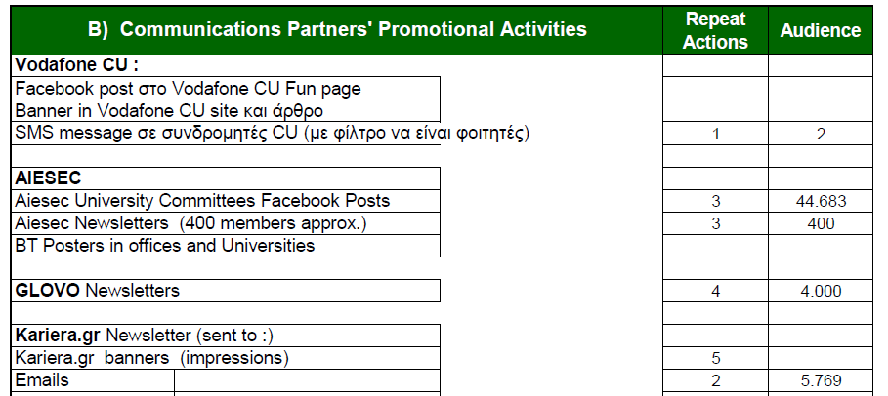
2d. Direct Impacts : BT own Media

Slide 35
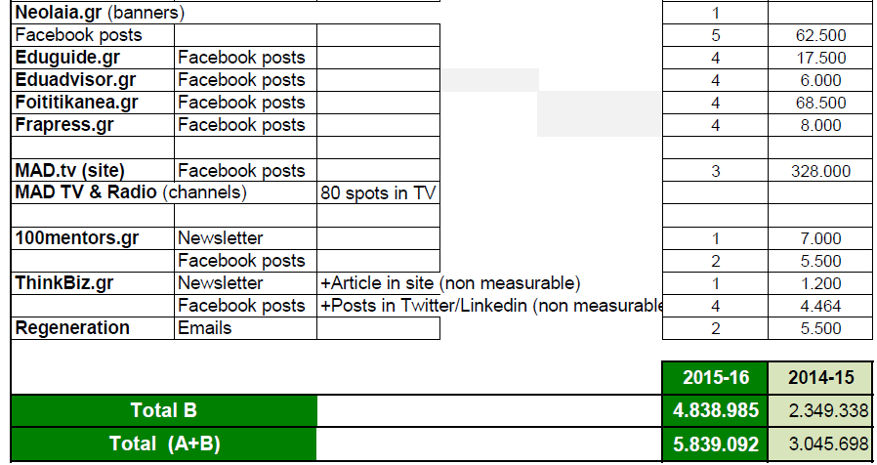
2d. Direct Impacts : BT own Media
+105%
+92%

Slide 36


Join this unique program!
And develop your potential as future leader - professional
www.businesstalents.com

Slide 37

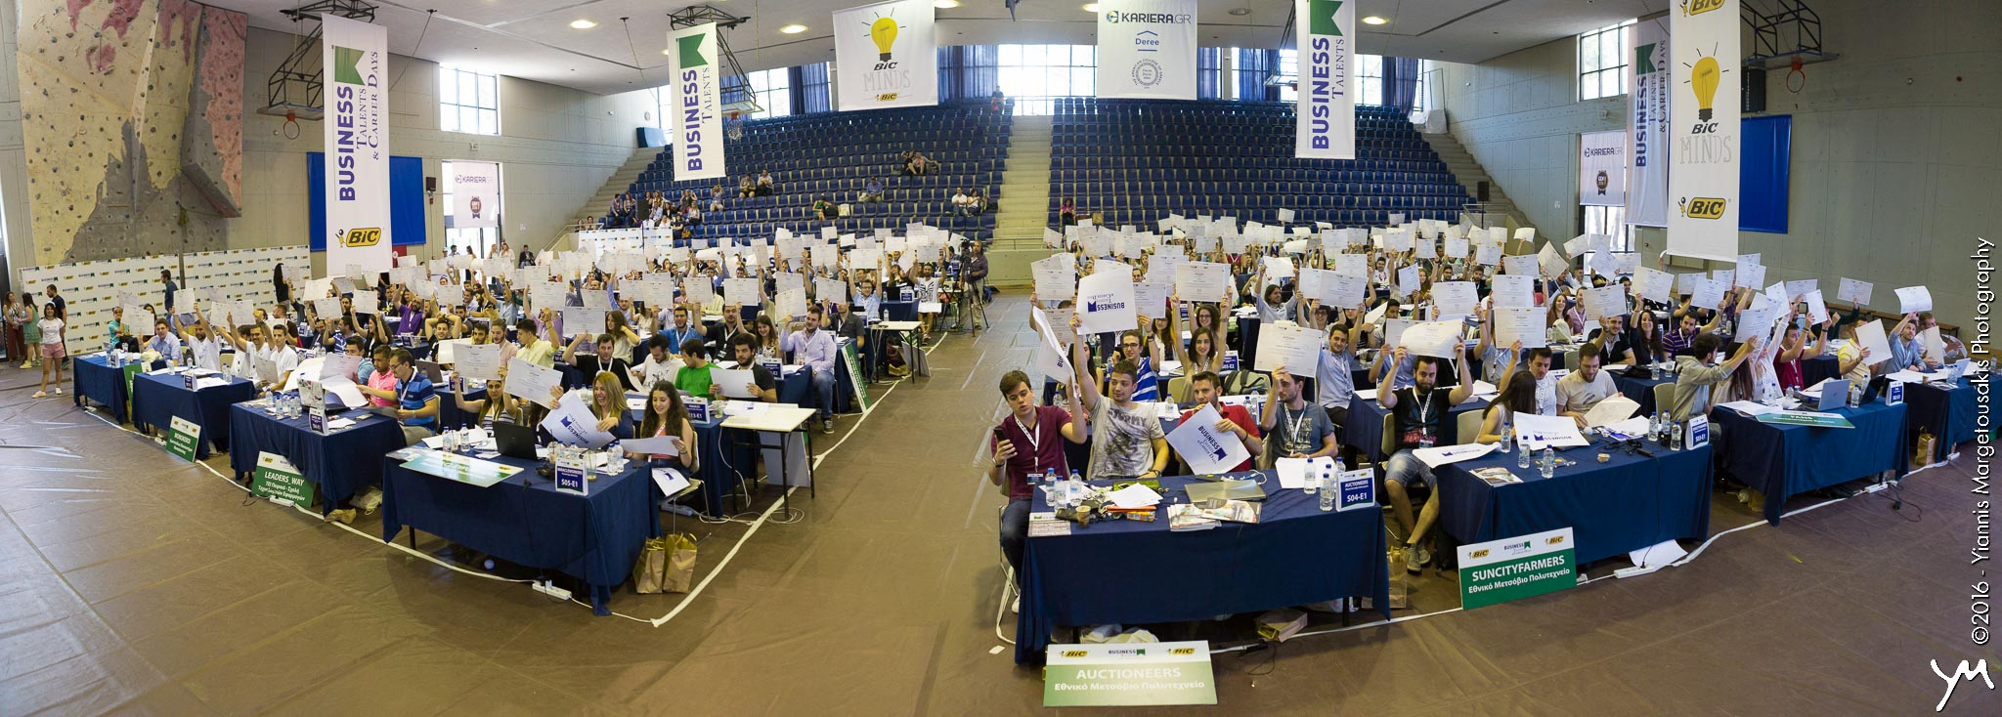

C U at the Final !

Slide 38
DZIęKI
MERCI
THANK YOU
TAK
GRACIAS
DANK
Ευχαριστώ
Gracie

